Slide 1
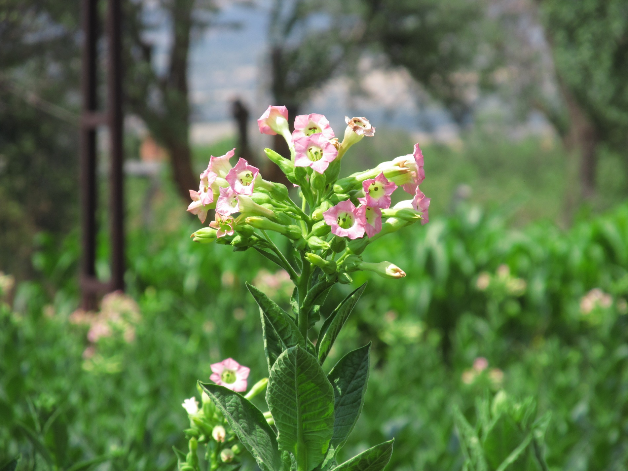
TURKISH TOBACCO SEEDLING STAGE
AND
TOBACCO DISEASES AND PESTS

Slide 2
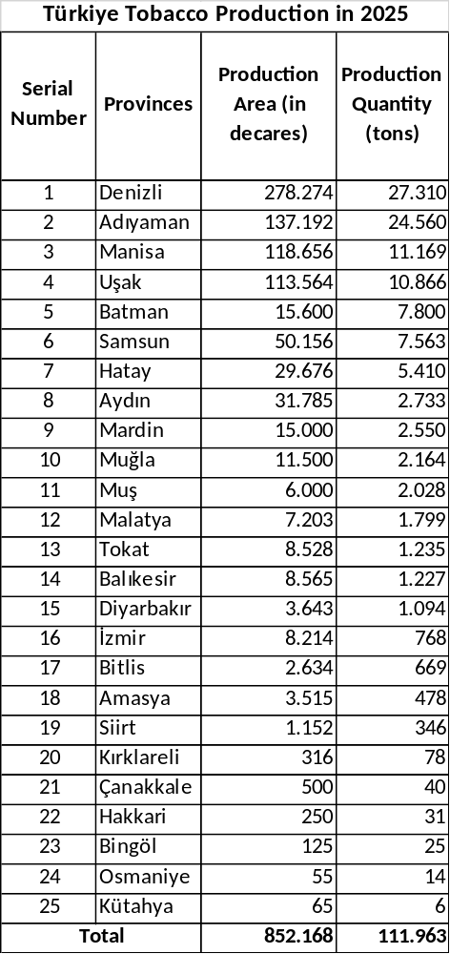
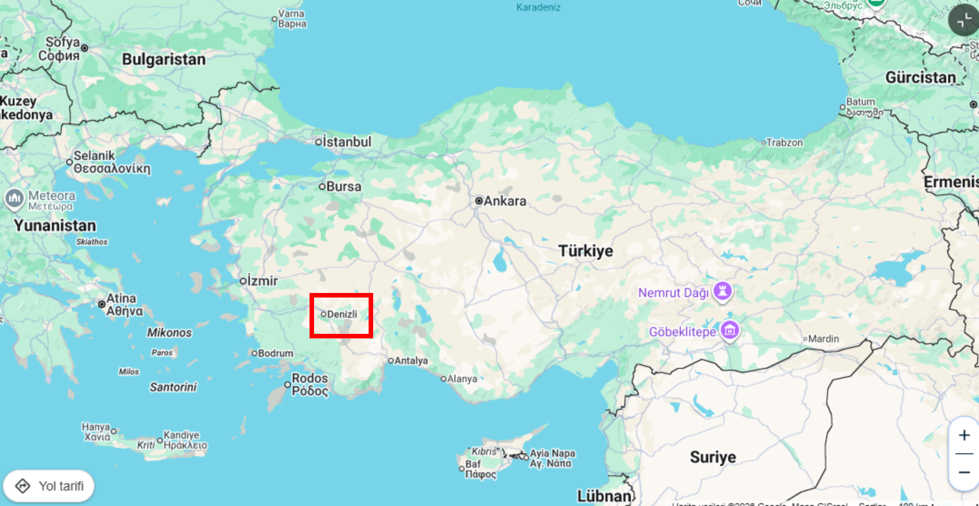
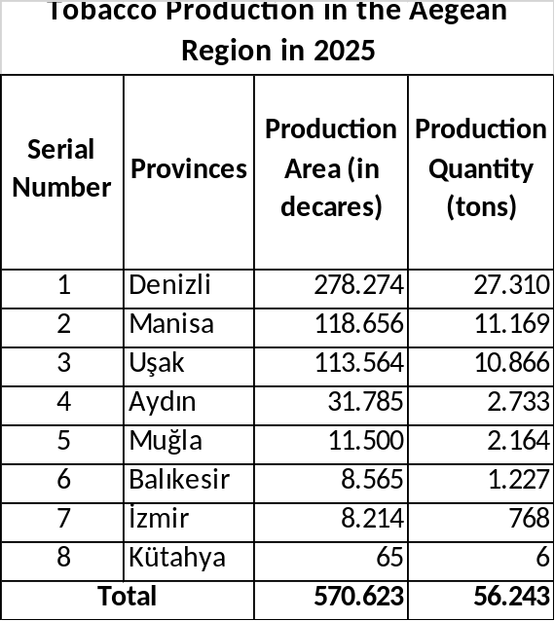
TOBACCO PRODUCTION
Denizli ranks first in tobacco production in Türkiye.
Denizli is 1st with 27,310 tons of production.
Adıyaman is 2nd with 24,560 tons.
Manisa is 3rd with 11,169 tons.

Slide 3
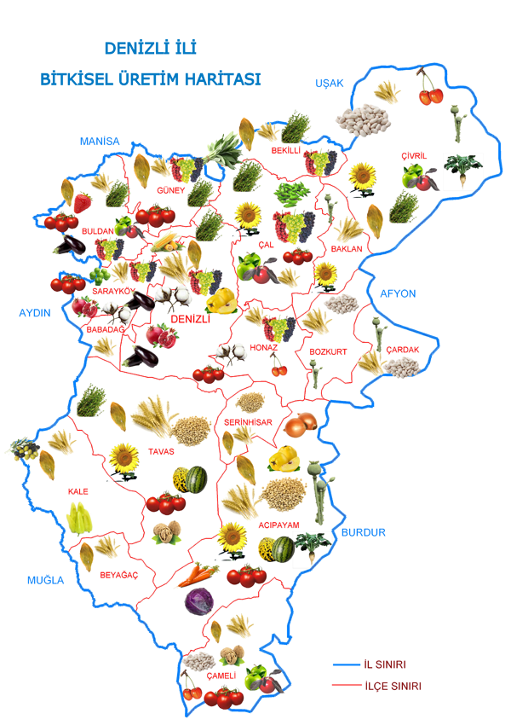
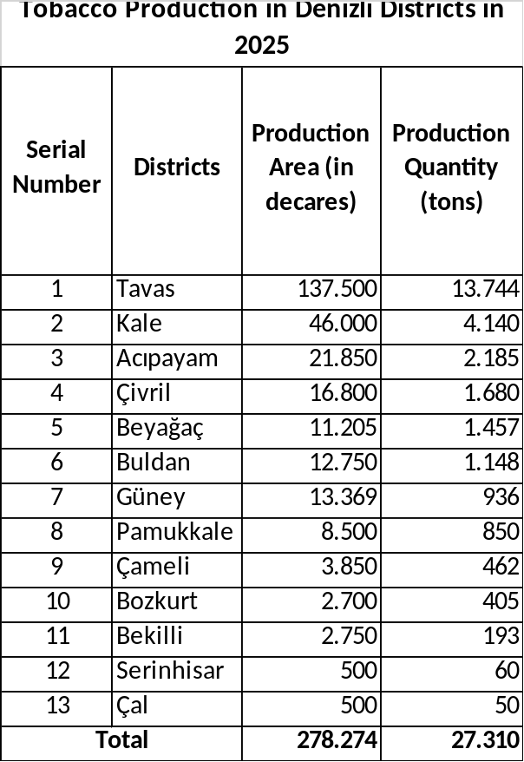
TOBACCO IN DENIZLI

Slide 4
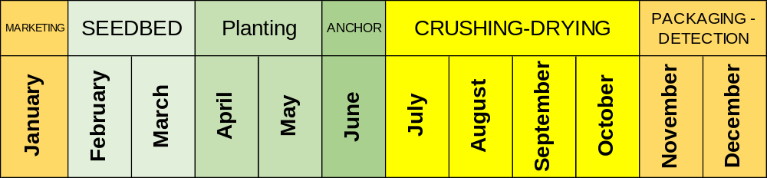
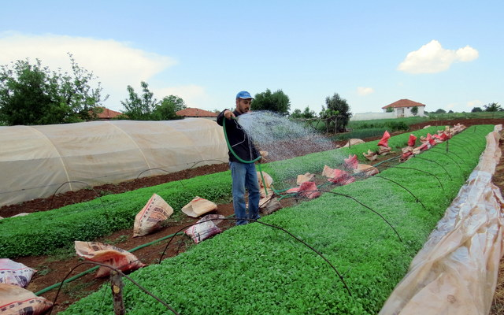
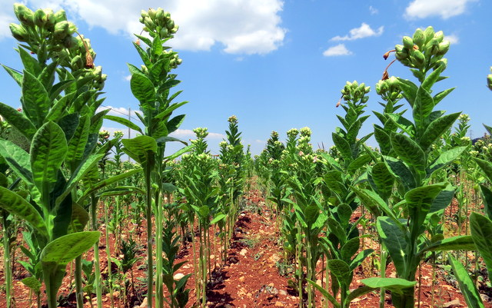
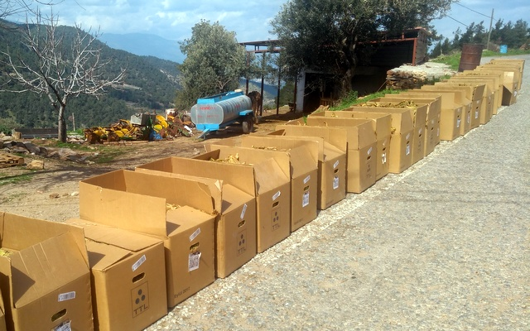
TOBACCO IS A PROCESS THAT LASTS FOR 12 MONTHS.
Today, we will take a closer look at diseases and pests during the seedling and field stages, and especially the viral disease, thrips, that has caused yield and quality losses in previous years.

Slide 5
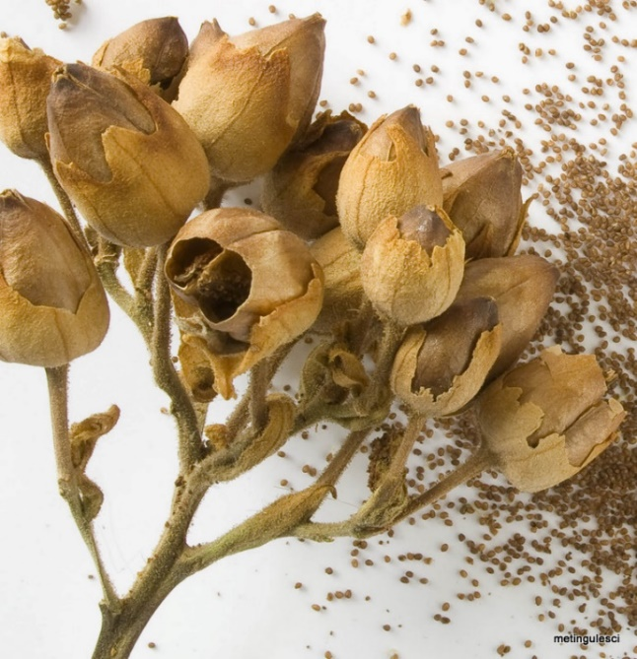
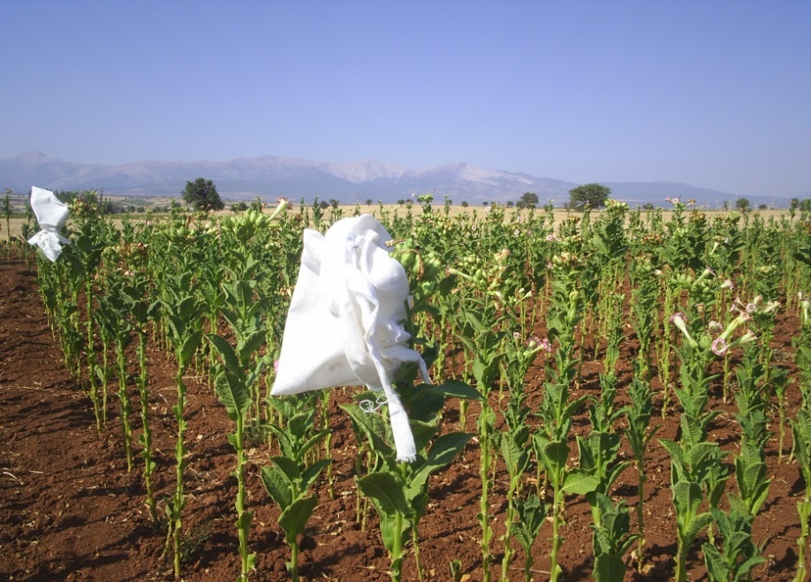
SEED
Production is carried out with certified tobacco seeds from the following varieties:
Akhisar 97, İzmir Özbaş, Sarıbağlar
Certified
Birlik 124 and Birlik 128
and village variety tobacco seeds. Use certified tobacco seeds first.
Obtain seeds from good-looking, leafy, disease-free tobacco plants during harvest time.

Slide 6
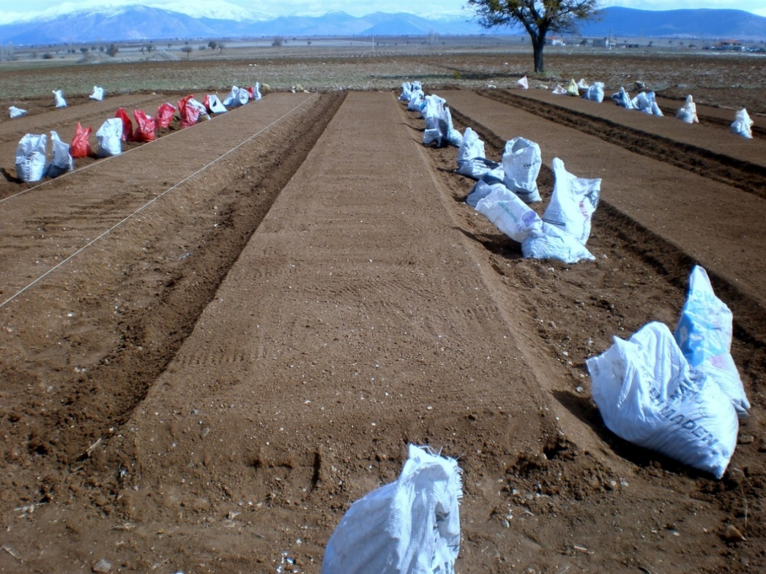
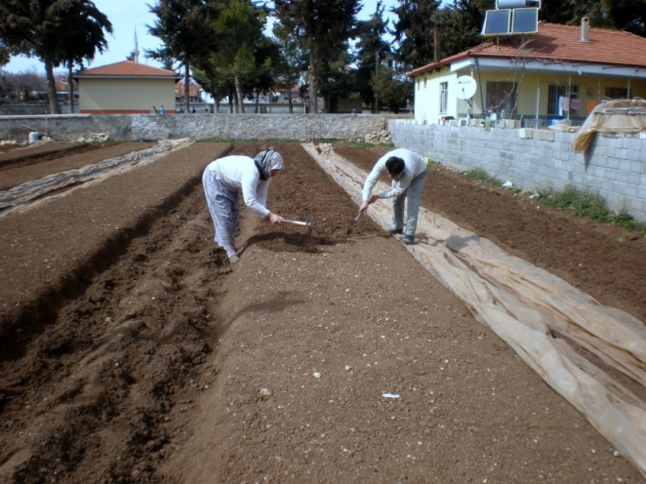
SELECTION OF NURSERY SITE
1- Seedling beds should be in well-drained areas; the soil should NOT become muddy from irrigation.
2- Care should be taken to ensure that seedling beds receive sunlight at all hours of the day.
3- To remove excess water from the root zone, seedling beds should be made 10-15 cm ABOVE soil level.
4- Seedling beds should be 100-120 cm wide and a maximum of 15 m long. When preparing seedling areas with the specified dimensions, 1-1.5 kg of compound fertilizer, preferably 15-15-15, can be mixed in.

Slide 7
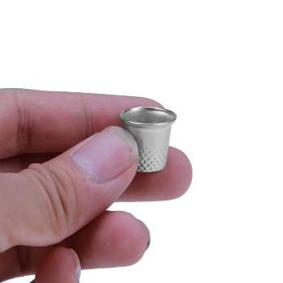
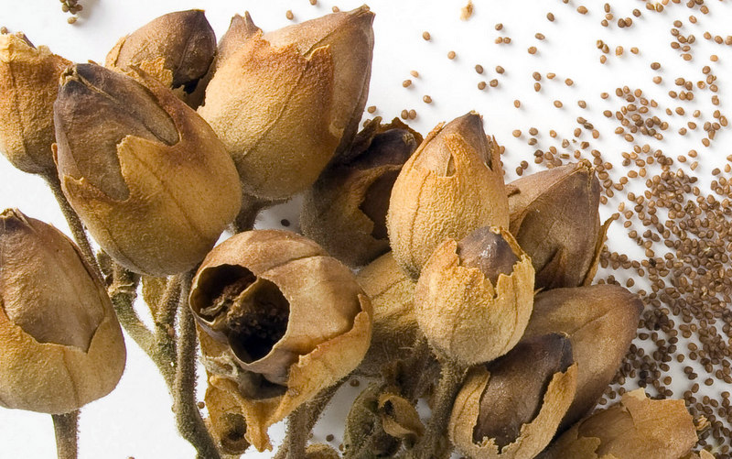
WHY 1 GRAM OF SEED?
In October, the amount of seed is calculated as 1 gram per m² or 1 thimble per square meter.

Slide 8
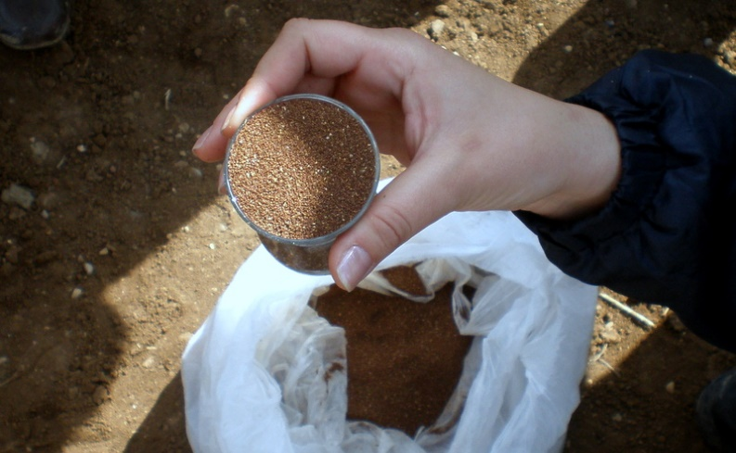
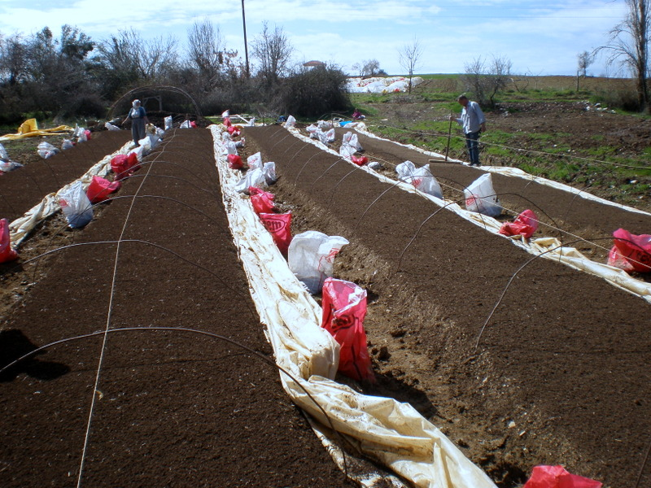
NURSERY AREA CALCULATION
One gram contains 10-12 thousand tobacco seeds. 50-60% of uncertified tobacco seeds may germinate.
From one gram of tobacco seed sown per square meter, 4-5 thousand healthy seedlings can be obtained. In our region, an average of 16-18 thousand seedlings are planted per decare of tobacco field. 4-6 m² of seedling area is sufficient for one decare of tobacco field.

Slide 9
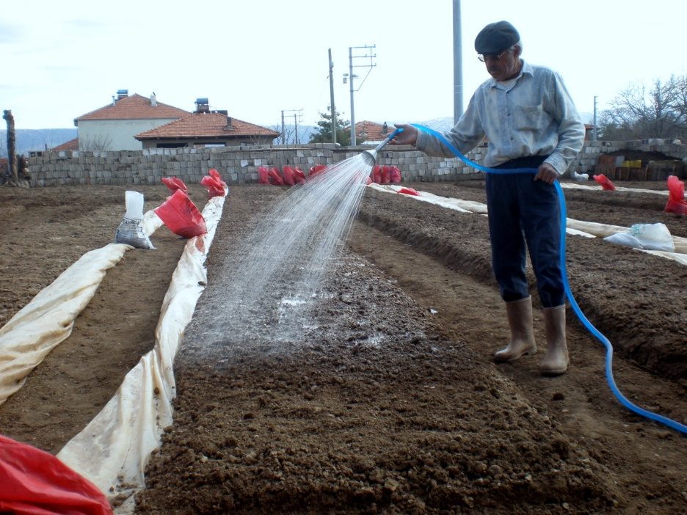
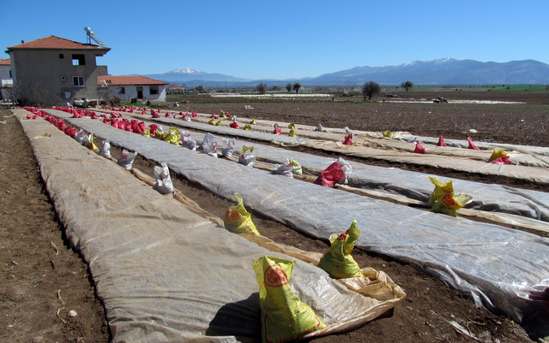
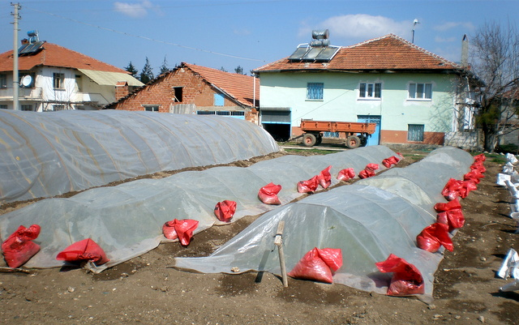
PLANTING ON TIME
Seeds require a minimum temperature of 12–14ºC to germinate.
In early plantings, the soil temperature will not have reached the desired level, some seeds will rot, and germination will not be uniform.

Slide 10
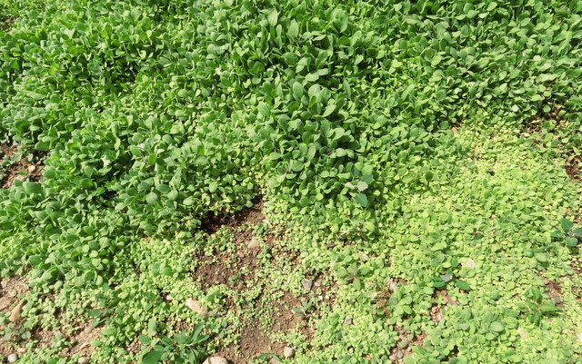
DO NOT USE TOO MUCH SEED.

Slide 11
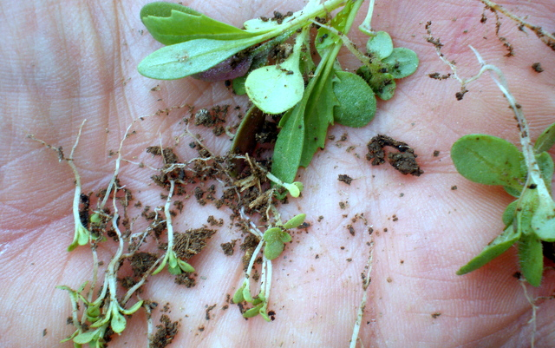
DO NOT USE TOO MUCH SEED.

Slide 12
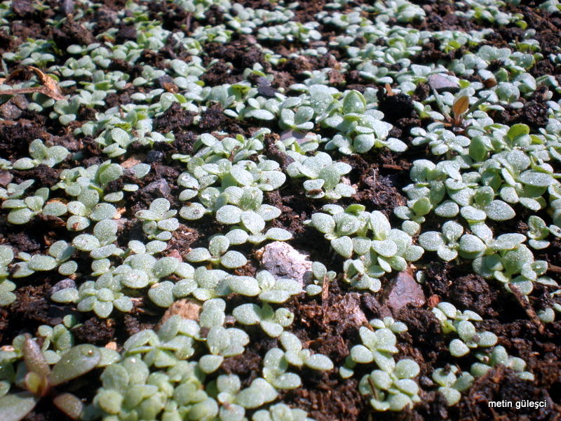
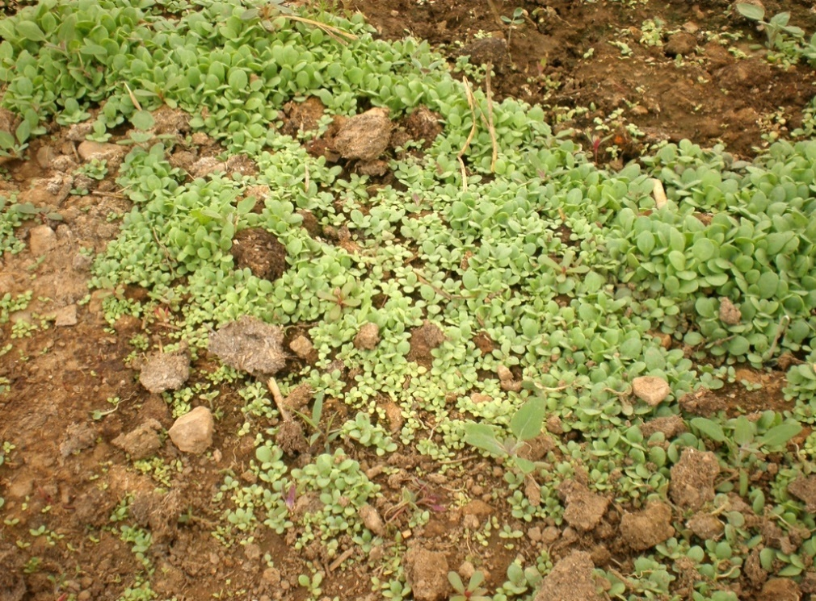
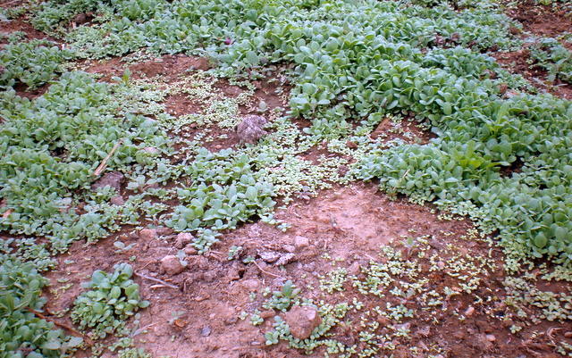
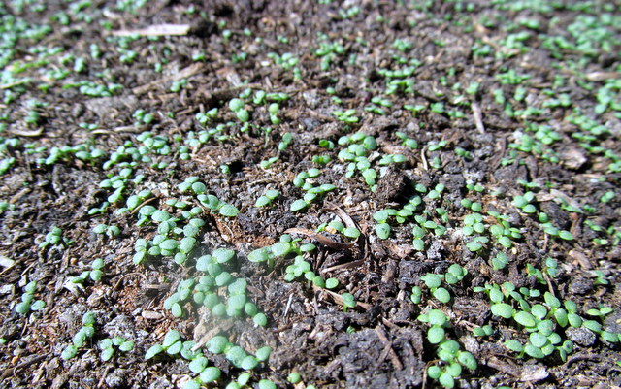
FAULTY NURSERY PRACTICES
X

Slide 13
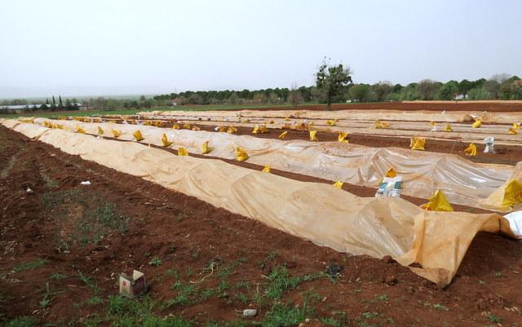
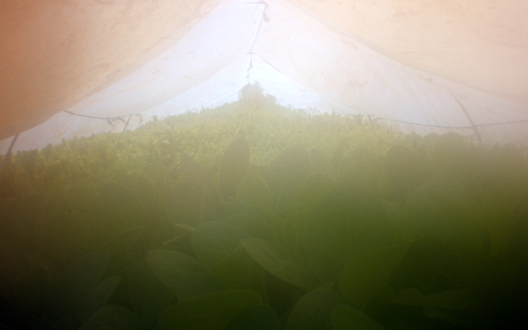
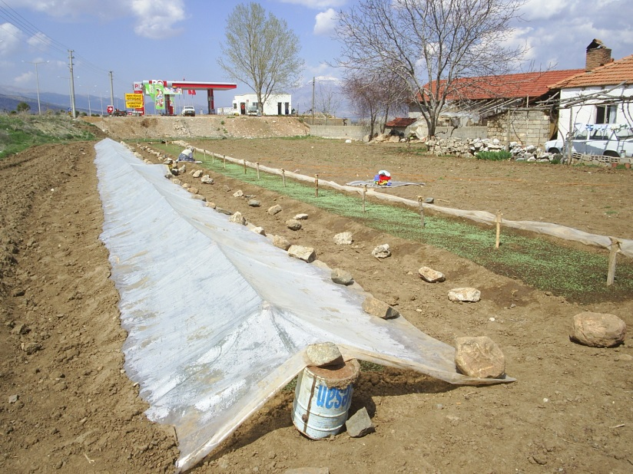
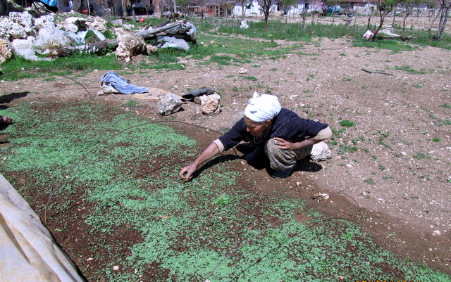
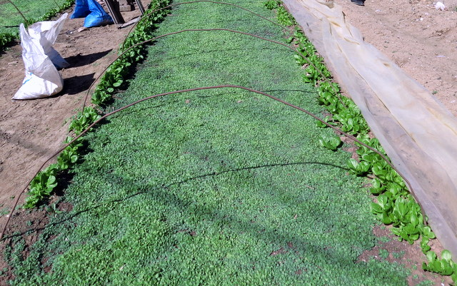
FAULTY NURSERY PRACTICES
X

Slide 14
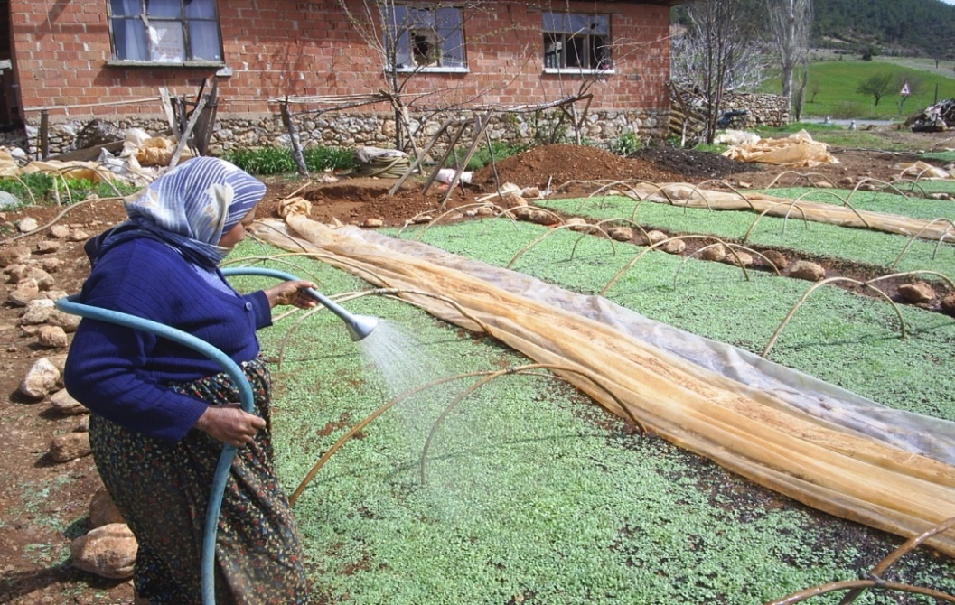
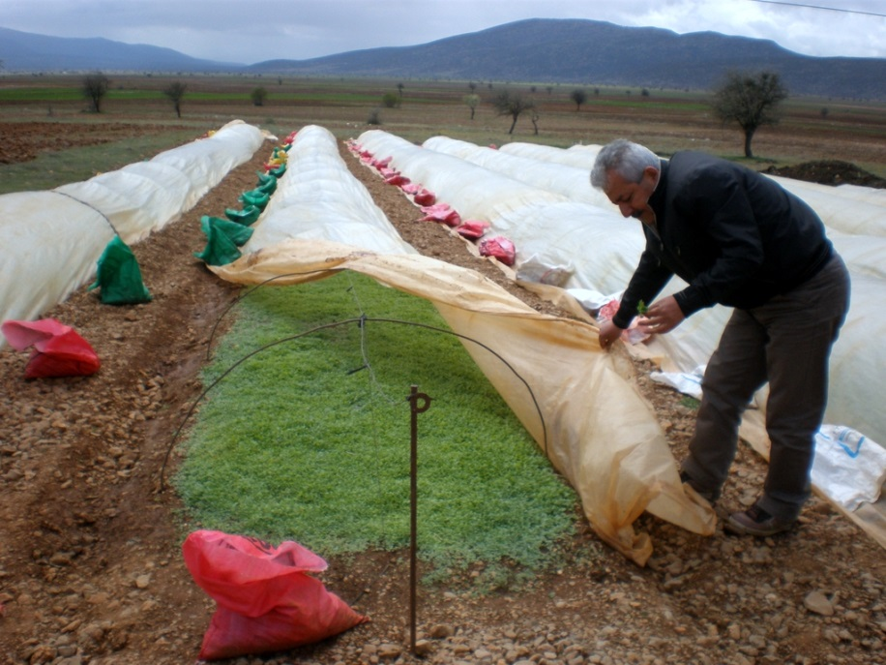
IRRIGATION-AERATION
Watering should generally be done in the mornings. The seedlings should go into the night dry.

Slide 15
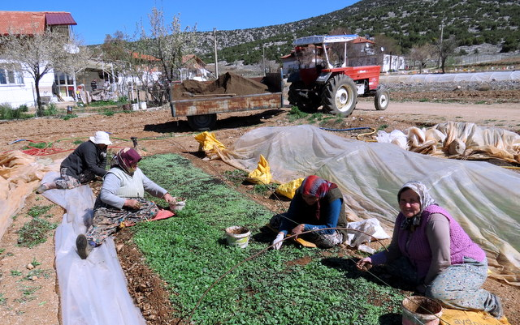
THINNING AND WEED REMOVAL
When the seedlings have 4 ears, weeds are removed from the nursery and thinning is carried out.

Slide 16
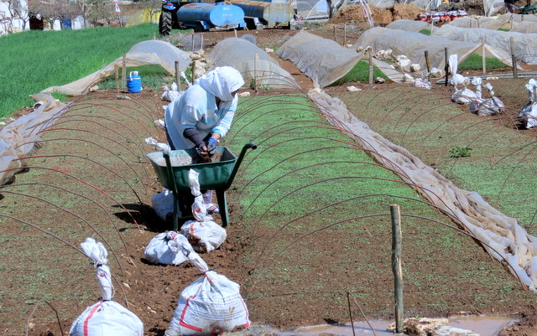
COVER THROW-OFF
In areas with dense weeding and frequent seeding, thinning is followed by the application of topsoil fertilizer and irrigation.

Slide 17
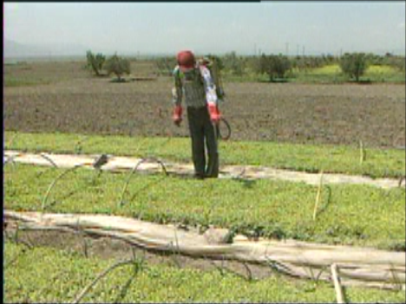
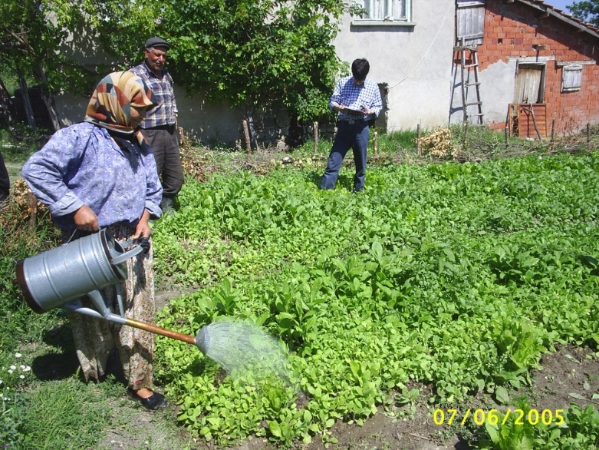
SEEDLING FEEDING
Although 15-15-15 compound fertilizers are used when preparing the nursery, the fertilizer is washed away from the soil due to irrigation.
To promote strong root development in seedlings, fertilizers containing natural humic acid or fulvic acid with added nitrogen and phosphorus can be used immediately after sowing the seeds or one week later.
When the seedlings have 6 leaves, dissolve 1-1.5 kg of compound fertilizer in lukewarm water for every 15 meters of seedlings, mix it with water, and apply it using a watering can with a sieve. Immediately afterward, water with clean water.
Foliar fertilizers, readily available on the market, can be applied every 10 days when the seedlings reach 5 cm in height. They can be applied a maximum of 3 times.
In addition, 500 g of mixture/100 liters of water;
130 g of ammonium sulfate (sugar)
310 g of superphosphate
50 g of potassium sulfate
10 g of magnesium sulfate
mixture is applied with a strainer bucket, followed by light watering.

Slide 18
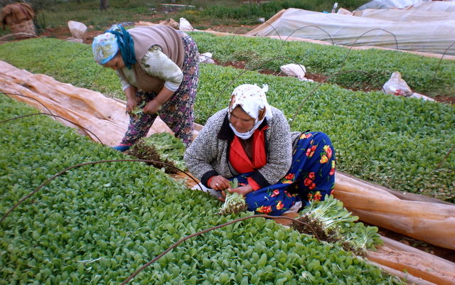
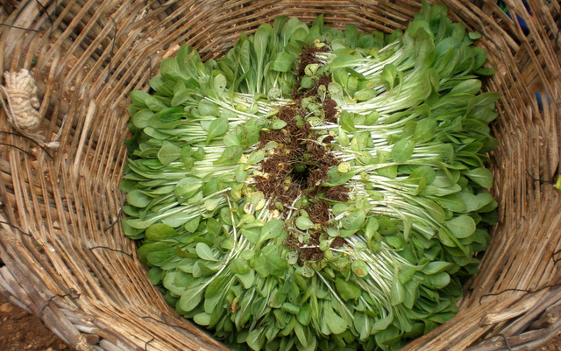
REMOVING THE SEEDLINGS
For planting, mature seedlings that are 15 cm tall and have 4–5 leaves are pulled out by holding them by the ear-shaped leaves.

Slide 19
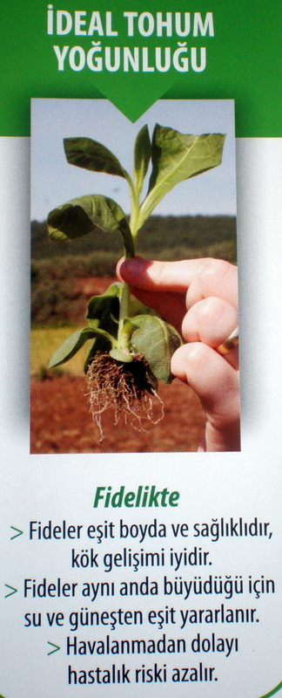
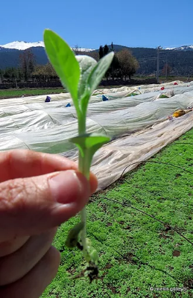
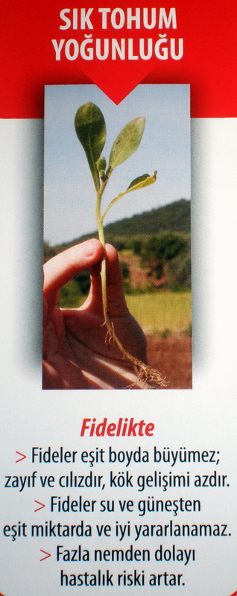
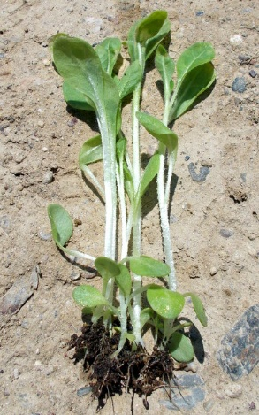
TOBACCO SEEDLING
Before planting, tobacco seedlings of the same size and free from disease and pest risk should be selected.
Ideal seed density
High seed density

Slide 20
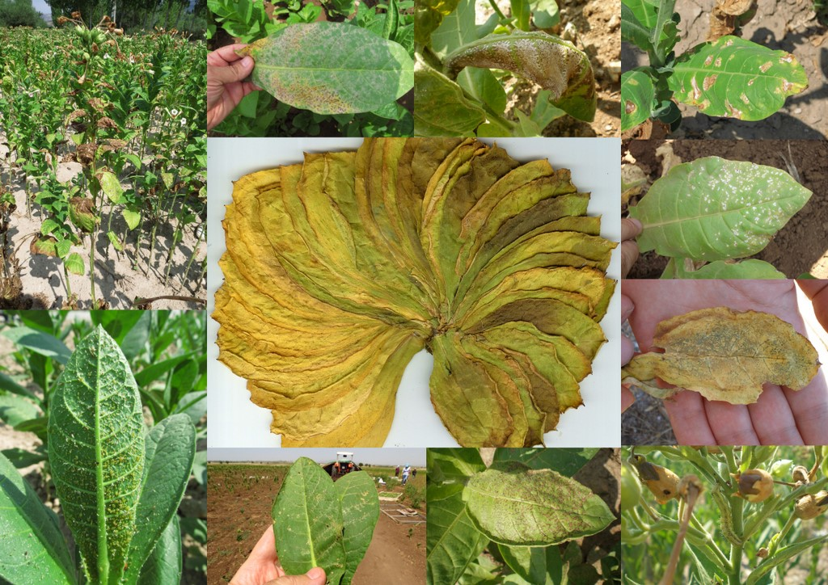
DISEASES AND PESTS

Slide 21
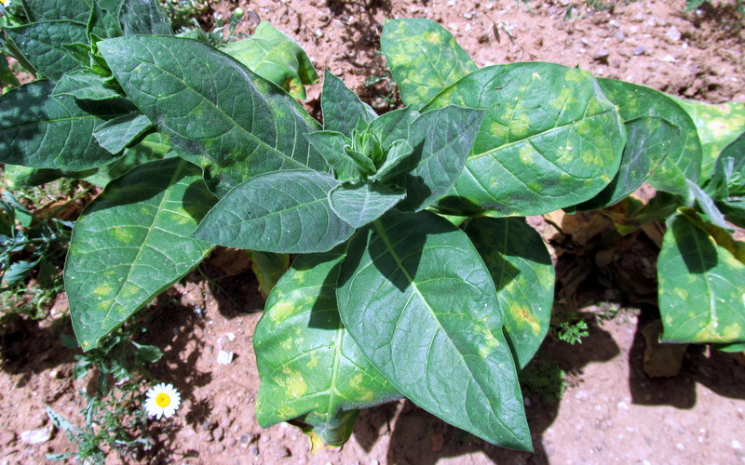
MILDEW (BLUE MOLD) DISEASE
Peronospora tabacina D.B. Adam
FIELD PERIOD
The optimal temperature for disease development is 18–24 °C, and the disease will develop if the weather is cloudy, rainy, and humid.

Slide 22
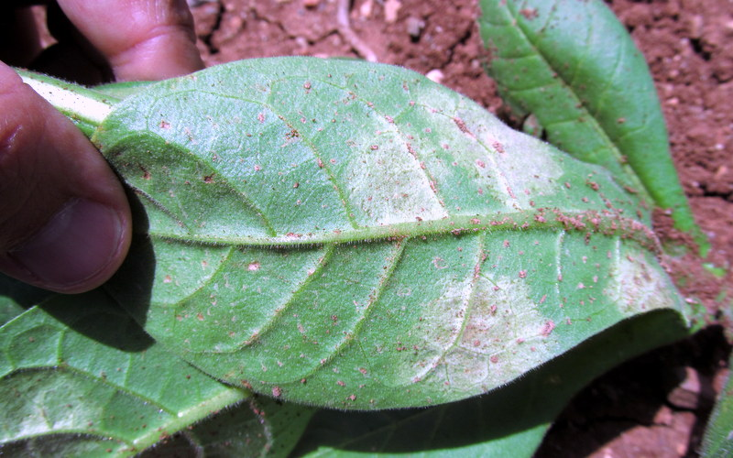
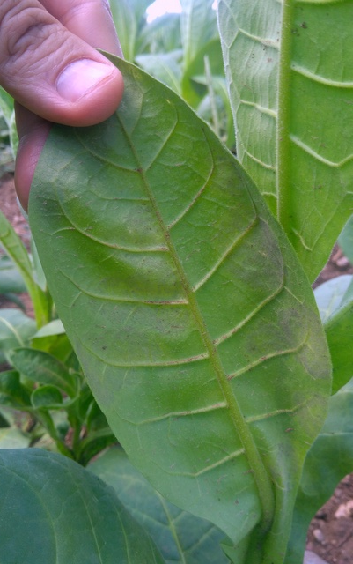
MILDEW (BLUE MOLD) DISEASE
Peronospora tabacina D.B. Adam
The most common symptom of the disease is the formation of bluish-gray or dirty white spots on the underside of the leaves.
Preventive spraying should be done before rainy, cloudy and warm weather conditions.

Slide 23
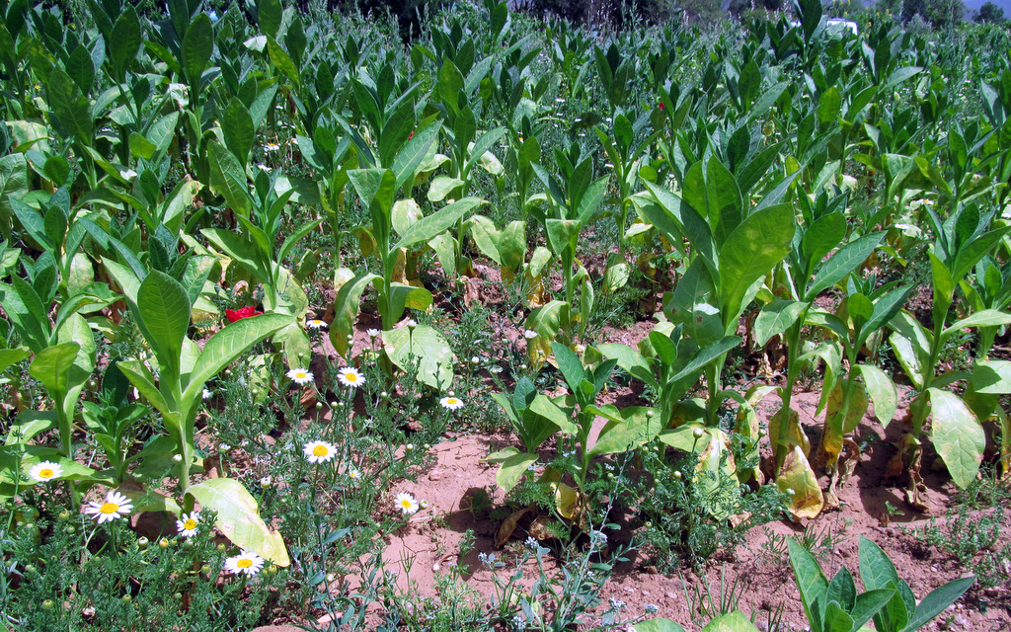
MILDEW (BLUE MOLD) DISEASE
Peronospora tabacina D.B. Adam
If weather conditions are favorable, the fungus will spread and cause outbreaks.

Slide 24
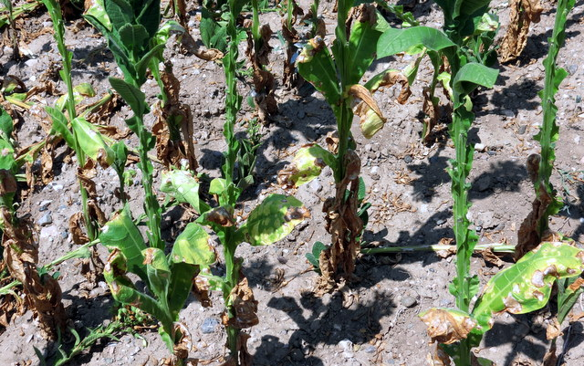
MILDEW (BLUE MOLD) DISEASE
Peronospora tabacina D.B. Adam
It is observed more intensely in our region after the June rains. In addition, the disease environment is also ready in plots using sprinkler irrigation systems. It is a devastating disease.

Slide 25


MILDEW (BLUE MOLD) DISEASE
Peronospora tabacina D.B. Adam
Diseased Leaves

Slide 26

MILDEW (BLUE MOLD) DISEASE
Peronospora tabacina D.B. Adam
Seedling Stage: Conditions during the seedling stage are favorable for the disease. Diseased seedlings are yellower than healthy ones. The tip of the seedling leaf curls downwards. There is a gray-blue mold layer under the yellowing on the leaf.
Disease is inevitable when the temperature is between 18-24 ºC and the humidity is 80%.
Care should be taken in rainy, cloudy and warm weather.
Attention should be paid to ventilation.
Seedling beds should not be longer than 15 meters.
Dense planting should be avoided.

Slide 27

MILDEW (BLUE MOLD) DISEASE
Peronospora tabacina D.B. Adam
PEST CONTROL
Spraying in the nursery should be done in the early morning, 2 hours after watering, and in still weather.
Leaves should be dry when applying blue mold spray.
If weather conditions are favorable for the disease, spraying should be repeated.

Slide 28

MILDEW (BLUE MOLD) DISEASE
Peronospora tabacina D.B. Adam
Overdose in pesticide application

Slide 29


Rhizoctonia solani J.G.Kühn., Fusarium spp., Pythium spp., Alternaria spp., Sclerotinia sclerotiorum (Lib.) de Bary.
DAMPING OFF
Five different types of fungi that live in the soil cause diseases in seedlings.ayan 5 değişik mantar fidelerde hastalık yapar.
Infections that occur before the seed germinates and emerges from the soil create empty spaces in the seedling nursery.
In post-emergence infections, yellowing is observed in newly emerged seedlings. The roots do not develop well and are not white. Diseased seedlings turn brown near the root collar. As a result of rotting, the seedling falls over and dries out.

Slide 30




Rhizoctonia solani J.G.Kühn., Fusarium spp., Pythium spp., Alternaria spp., Sclerotinia sclerotiorum (Lib.) de Bary.
DAMPING OFF

Slide 31

Rhizoctonia solani J.G.Kühn., Fusarium spp., Pythium spp., Alternaria spp., Sclerotinia sclerotiorum (Lib.) de Bary.
DAMPING OFF
1- High soil moisture
2- Below-normal air temperatures
3- Dense planting
These factors accelerate the development of damping-off disease.
When the disease is observed, irrigation should be minimized. In fact, irrigation should be avoided altogether unless wilting due to lack of water is observed in the seedling leaves.

Slide 32



PEST CONTROL
Rhizoctonia solani J.G.Kühn., Fusarium spp., Pythium spp., Alternaria spp., Sclerotinia sclerotiorum (Lib.) de Bary.
DAMPING OFF
Immediately after sowing the seeds, apply 3-4 liters of medicated water per square meter. After the seedlings have fully emerged, repeat the treatments every 8-10 days. Spraying should be done with a bucket with a sieve. Clean water should be given after spraying.
In severe infections, copper-based pesticides should be preferred.

Slide 33

Rhizoctonia solani J.G.Kühn., Fusarium spp., Pythium spp., Alternaria spp., Sclerotinia sclerotiorum (Lib.) de Bary.
DAMPING OFF
Formation of black-blue colored sclerotia due to damping-off agents in tobacco seedlings.

Slide 34


POWDERY MILDEW DISEASE
Erysiphe cichoracearum D.C.
Powdery mildew is a field-season disease. One or two applications (systemic) in late June or July are usually sufficient.

Slide 35


APHIDS
Myzus persicae
Due to the sweet substance that aphids secrete during feeding, a grayish, honeydew-like layer covers the leaves. This layer hinders photosynthesis and respiration. It also causes the leaves to stick together during drying, to break apart during processing, and negatively affects quality.
In addition to the damages listed above, aphids are carriers of some viral diseases and should therefore be closely monitored.

Slide 36


TOBACCO MOSAIC VIRUS (TMV)
Mosaic symptoms and swelling occur in young leaves, manifesting as light yellow-green and dark green discoloration.
It is transmitted through contact, seeds, and certain insect species with biting or chewing mouthparts.
Control measures should be taken against vector insects, especially aphids.

Slide 37




WILD FIRE
Pseudomonas syringae pv. tabaci
It is a bacterial disease. It overwinters in plant debris. It is carried to the leaves by raindrops and wind. The disease spreads easily in rainy and humid weather, causing dead areas on the leaves. The pathogen disappears as the weather warms up.

Slide 38




TOBACCO FLEAS
Epitrix hirtipennis

Slide 39


OROBANCHE RAMOSA
It is observed in all tobacco fields throughout the province. There is no licensed pesticide available. It threatens production. Production should not be carried out in infected fields.

Slide 40



FALSE BROOMRAPE
These are small or large white, whitish growths resembling popcorn kernels on the root system. They are called "false broomrape" because they resemble broomrape.
It is reported that false broomrape is not transmitted through seeds, but diseased tissue fragments and soil can cause new infections.
It has been determined that the formation of false broomrape causes stunted growth in the plant and can even kill it. It is common in our region. It is thought to particularly affect tobacco harvested in September.

Slide 41



CUSCUTA SPP.

Slide 42



HELICOVERPA ARMIGERA
It causes damage to tobacco plants during July and August.

Slide 43


NEMATODE
Meloidogyne incognita

Slide 44



LOCUST DAMAGE
Egyptian grasshopper

Slide 45



COLD DAMAGE IN SEEDLINGS

Slide 46


HERBICIDE APPLICATION

Slide 47


WHEATHER FLECK
Wheather fleck, a physiological leaf spot disease, first appears on mature and lower leaves. The extent of damage increases depending on the length of time air (ozone - O3) enters the stomata of tobacco leaves and remains in the spaces. It is commonly seen in our region. It is reported to be more prevalent in areas with air pollution.

Slide 48

Planting date: May 10
20 MAY

Slide 49

Planting date: May 10
20 MAY

Slide 50

Planting date: May 10
20 MAY

Slide 51

THRİPS TABACİ
Planting date: May 10
20 MAY

Slide 52

THRİPS TABACİ
Planting date: May 10
20 MAY

Slide 53

THRİPS TABACİ
Planting date: May 10
20 MAY

Slide 54

THRİPS TABACİ
They reproduce by laying unfertilized eggs. Male individuals are very rare in nature. They can produce 3-4 generations a year, and even more under suitable conditions.

Slide 55

THRİPS TABACİ
Typically, a female lays 30 eggs. The development period from egg to adult takes 2-3 weeks.

Slide 56




THRİPS TABACİ DAMAGE

Slide 57




THRİPS TABACİ DAMAGE
Their growth and reproduction accelerate during dry years.
Rain significantly reduces the population by washing the pest off the plant.
In addition to the damage you see, thrips transmit and spread the tomato spotted wilt virus.

Slide 58

TOMATO SPOTTED WILT VIRUS (TSWV)
Tobacco plants infected with the virus become stunted, drooping and bending as if broken. Diseased plants cannot develop and fall off and die after a few weeks.

Slide 59

TOMATO SPOTTED WILT VIRUS (TSWV)
At temperatures of 25°C, symptoms can appear in 5 days, while at 10-12°C, they can appear in 3 weeks.

Slide 60

TOMATO SPOTTED WILT VIRUS (TSWV)
At temperatures of 32°C and above, the virus enters a dormant phase and shows no symptoms.
During this phase, if unflowered tobacco plants find water, they revive and show a second growth.
While some of the newly emerged leaves show signs of disease, quality leaves can also be obtained.

Slide 61

TOMATO SPOTTED WILT VIRUS (TSWV)
In any case, there are losses in efficiency and quality.

Slide 62


TOMATO SPOTTED WILT VIRUS (TSWV)

Slide 63


TOMATO SPOTTED WILT VIRUS (TSWV)
TSWV-infected diseased leaves

Slide 64


TOMATO SPOTTED WILT VIRUS (TSWV)
The disease is transmitted by thrips, which are vector insects.
Thrips larvae acquire viruses when they feed on diseased plants. As adults, they transmit the virus to tobacco plants they feed on. The virus is not transmitted through thrips eggs.

Slide 65




TOMATO SPOTTED WILT VIRUS (TSWV)
The disease is observed in many cultivated plants such as tomatoes, peppers, and lettuce, and this viral disease is found as a host in weeds and ornamental plants.

Slide 66
TOMATO SPOTTED WILT VIRUS (TSWV)
STRUGGLE
There is no medicinal treatment for this viral disease.
Since the virus can be carried in the seed coat, certified seeds should be used, and seeds should not be taken from diseased plants.
Most infections occur during the seedling stage. In cool weather, disease symptoms can be seen in 3 weeks. Apply thrips treatment when the seedling leaves are dry. Use different insecticides. The easiest and cheapest control is done in the seedling stage.
Care should be taken to ensure that there are no plants such as tomatoes, peppers, lettuce, and onions, or weeds near the seedling area and field. The disease has many hosts.

Slide 67
TOMATO SPOTTED WILT VIRUS (TSWV)
STRUGGLE
Thrips control should be carried out in planted fields. Thrips can spread over very large areas by wind and can be found everywhere. Field control is both difficult and expensive.
Diseased plants should be removed from the production area and destroyed.
The number of thrips affects the transmission and spread of the disease. This disease is commonly seen after mild winters.
Many tobacco producers do not believe that this disease is transmitted by thrips and attribute it to other causes. When the cause of the disease is unknown, control cannot be successful.
Tobacco production has been abandoned in many parts of the world due to this disease.

Slide 68

TOBACCO
The first step to successful pest control is the CORRECT DIAGNOSIS of the disease or pest.
The pesticides you use must clearly state "TOBACCO" on their packaging and labels.
For field spraying, you must know the amount of water needed to COVER THE LEAVES AND NOT RUNNING OUT, according to the phenology of the tobacco plant per decare. To do this, you must calibrate (adjust) your spraying equipment. For example, 20 liters/decare for newly planted tobacco, and 40 liters/decare for tobacco with 10-15 leaves.
First, mix the pesticide with water in a small container. After filling one-third of the pesticide tank with water, add the prepared mixture and the remaining two-thirds water. The agitator of the sprayer must be working during this process.

Slide 69

TOBACCO
Do not exceed the recommended dose. Excessive doses lead to resistance development in pests, reducing the effectiveness of subsequent applications. Similarly, excessive use of fungicides can cause stunted growth and toxic effects in plants.
Especially during field applications, adhere to the required waiting period between application and harvesting. Chemicals applied in the recommended amount begin to break down under the influence of weather conditions. After the waiting period, the chemical residue level (mrl) on the leaves reaches a level that does not threaten human health. If you use a high dose, the chemical residue level (mrl) remaining on the leaves after the waiting period will be high, resulting in tobacco with residue.
Companies take samples for residue analysis in tobacco contracts. In addition, foreign purchasing companies also take samples from the tobacco they will purchase and have them analyzed; only tobacco that is clean can be exported. Carry out pest control meticulously to ensure the continuity of production and export.

Slide 70
Thank you
Metin GULESCI
Tobacco Technology Engineer
https://www.turkishtobacco.net/

